Slide 1
Compiling GMAT
Joel Parker
KARI
September 26, 2012

Slide 2
Overview
GMAT is a complex app with many different configurations
Three platforms:
Windows
Mac OS X
Linux
Two architectures:
x86 (32-bit)
x86-64 (64-bit)
Can be built in different forms:
libGmatBase
GUI app
Console app
And in different configurations:
Debug or release
With or without supporting libraries
Also, offers several optional plugins

Slide 3
Technology Relationships
User
GUI
libGmatBase
Console
libCInterface
wxWidgets
Plugins
SPICE
F2C
Operating System

Slide 4
Build Targets
OS | Arch. | libGmatBase | GUI | Console | libMatlabInterface | libFminconOptimizer | all other plugins
Windows | x86 | ✓ | ✓ | • | ✓ | ✓ | ✓
 | x86-64 | • | • | • | • | • | •
Mac OS X | x86 | ✓ | ✓ | ✓ | •* | ✗ | ✓
 | x86-64 | ✓ | ✗ | ✓ | ✗ | ✗ | •
Linux | x86 | ✓ | ✓ | ✓ | •* | ✗ | ✓
 | x86-64 | ✓ | ✓ | ✓ | • | ✗ | ✓
libGmatBase
Base shared library
GUI
Graphical application (GMAT.exe)
Console
Console application (GMATConsole.exe)
Plugins
libMatlabInterface
libFminconOptimizer
libCInterface
libEstimation [alpha]
etc.
✓
Supported and regularly tested
•
Supported, but not tested
*Unsupported by new MATLAB releases
✗
Not supported

Slide 5
Build Systems
OS | Arch. | VS2010 | GCC | Next-Gen
Windows | x86 | ✓ | ✓ | •
 | x86-64 | • |  | •
Mac OS X | x86 |  | ✓ | •
 | x86-64 |  | ✓ | •
Linux | x86 |  | ✓ | •
 | x86-64 |  | ✓ | •
Visual Studio 2010
Windows-only
Performance and configuration benefits
GCC
Uses GNU tools
Can use Eclipse IDE
Uses MinGW/MSYS on Windows
Next-Generation (coming soon)
✓
Supported and regularly tested
•
Supported, but not tested
Not supported

Slide 6
Build Prerequisites
Microsoft Visual C++ 2010
Any edition (including Express)
Install and configure the Windows SDK to build GMAT 64-bit.
wxWidgets 2.8
GUI library
Latest is 2.8.12
SPICE (optional)
Adds support for SPICE ephemerides and propagation
Binaries from NAIF
F2C (optional)
Needed for MSISE atmosphere models
Binaries provided in GMAT repository
MATLAB (optional)
Needed by libMatlabInterface plugin

Slide 7
VS2010 Configurations
Debug
Used for development
Allows debugging in Visual studio
Release
Non-debug version, with F2C-based models
ReleaseWithoutF2C
Stripped-down, with minimal external dependencies
ReleaseWithSPICE
“Full” release, with SPICE
All available for x86 and x86-64
Configuration | wxWidgets | F2C | SPICE
Debug* | • |  | •
Release | • | •
ReleaseWithoutF2C | •
ReleaseWithSPICE | • |  | •
•
Required dependency
Supported and regularly tested configuration
* Debug configuration is currently not working; see GMT-2820

Slide 8
Build Process Walkthrough
OS: Windows
Architecture: x86 (32-bit)
Build System: VS2010
using Visual Studio 2010 Express
Build Targets: libGmatBase and GUI
Configuration: ReleaseWithSPICE
Required dependencies: wxWidgets, SPICE

Slide 9
Build Process Overview
Configure File System
Build wxWidgets
Build GMAT
Run

Slide 10
Step 1: Configure File System (1)
Gmat3rdParty\
GmatDevelopment\
Folder structure must exist as shown in working directory
Gmat3rdParty: prerequisites
GmatDevelopment: source code

Slide 11
Step 1: Configure File System (2)
Gmat3rdParty\
cspice\
data\
doc\
…
GmatDevelopment\
Visit http://naif.jpl.nasa.gov
“Toolkit”
“Toolkits for C”
“PC, Windows, Microsoft Visual C, 32bit”
Download cspice.zip
Extract to Gmat3rdParty

Slide 12
Step 1: Configure File System (3)
Gmat3rdParty\
cspice\
data\
doc\
…
wxWidgets\
art\
build\
…
GmatDevelopment\
Visit http://wxwidgets.org
“Downloads”
“Current Stable Release”
Download wxMSW (zip)
Extract to Gmat3rdParty
Rename to wxWidgets

Slide 13
Step 1: Configure File System (4)
Gmat3rdParty\
cspice\
data\
doc\
…
wxWidgets\
art\
build\
…
GmatDevelopment\
application\
build\
…
Check out GMAT sources from SourceForge
Use any Subversion tool:
TortoiseSVN
SmartSVN
Command-line tools
SVN URL: https://gmat.svn.sourceforge.net/svnroot/gmat/trunk

Slide 14
Step 2: Build wxWidgets (1)
wxWidgets includes build files for VS2005
GMAT includes modified files for VS2010
Find: GmatDevelopment\ build\ windows-VS2010\ wxWidgets.zip
Extract over Gmat3rdParty\wxWidgets, overwriting files

Slide 15
Step 2: Build wxWidgets (2)
Configure wxWidgets
In Visual Studio, open: Gmat3rdParty\wxWidgets\build\msw\wx_dll.sln
Expand the “adv” project, then “Setup Headers”
Open setup.h. Make sure this line is at the top: // Name: wx/msw/setup.h
Set this line from 0 to 1: #define wxUSE_GLCANVAS 1

Slide 16
Step 2: Build wxWidgets (3)
Build wxWidgets
In Visual Studio, choose the “DLL Release” configuration for Win32.
Right-click the solution and click “Build Solution”.
Repeat until 19 of the 20 projects build successfully.
In Visual Studio, open: Gmat3rdParty\wxWidgets\contrib\build\wxcontrib_dll.sln

Slide 17
Step 2: Build wxWidgets (4)
Build wxWidgets contributed libraries
In Visual Studio, open: Gmat3rdParty\wxWidgets\contrib\build\wxcontrib_dll.sln
Choose the “DLL Release” configuration for Win32.
Right-click the solution and click “Build Solution”.

Slide 18
Step 2: Build wxWidgets (5)
Copy DLL files
In Windows Explorer, open: Gmat3rdParty\wxWidgets\lib\vc_dll
Make sure you have 15 .dll files.
Copy these files to: GmatDevelopment\application\bin

Slide 19
Step 3: Build GMAT
In Visual Studio, open: GmatDevelopment\build\windows-VS2010\GmatVS2010.sln
Choose the ReleaseWithSPICE configuration for Win32.
Right-click the GMAT_wxGui project and click “Rebuild”.
The libGmatBase and GMAT_wxGui projects should complete successfully.

Slide 20
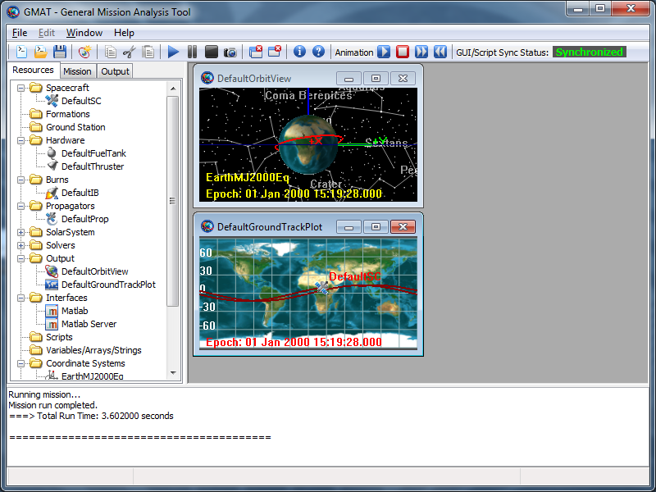
Step 4: Run GMAT
In Windows Explorer, open: GmatDevelopment\application\bin
Run GMAT.exe
Click Run to run the default mission.

Slide 21
Resources
All build instructions are linked from the “Compiling GMAT” wiki page:
http://gmat.ed-pages.com/wiki
“Development” on the left-hand menu
“Compiling GMAT” link
Contacts:
Any: Joel Parker (j.parker@nasa.gov)
Windows: Linda Jun (linda.jun@nasa.gov)
Mac OS X: Wendy Shoan (wendy.c.shoan@nasa.gov)
Linux: Darrel Conway (djc@thinksysinc.com)

Slide 22
Future
Next-generation build system in development
One, combined build system instead of two
Likely based on CMake or equivalent tool
Target: Mid-October
Will be available in parallel with current systems through R2013a release

